Slide 1

ER DIAGRAM OVERVIEW
FOR ACOUSTICA

Slide 2
Acoustica
A DBMS BASED MUSIC STREAMING PLATFORM

Slide 3
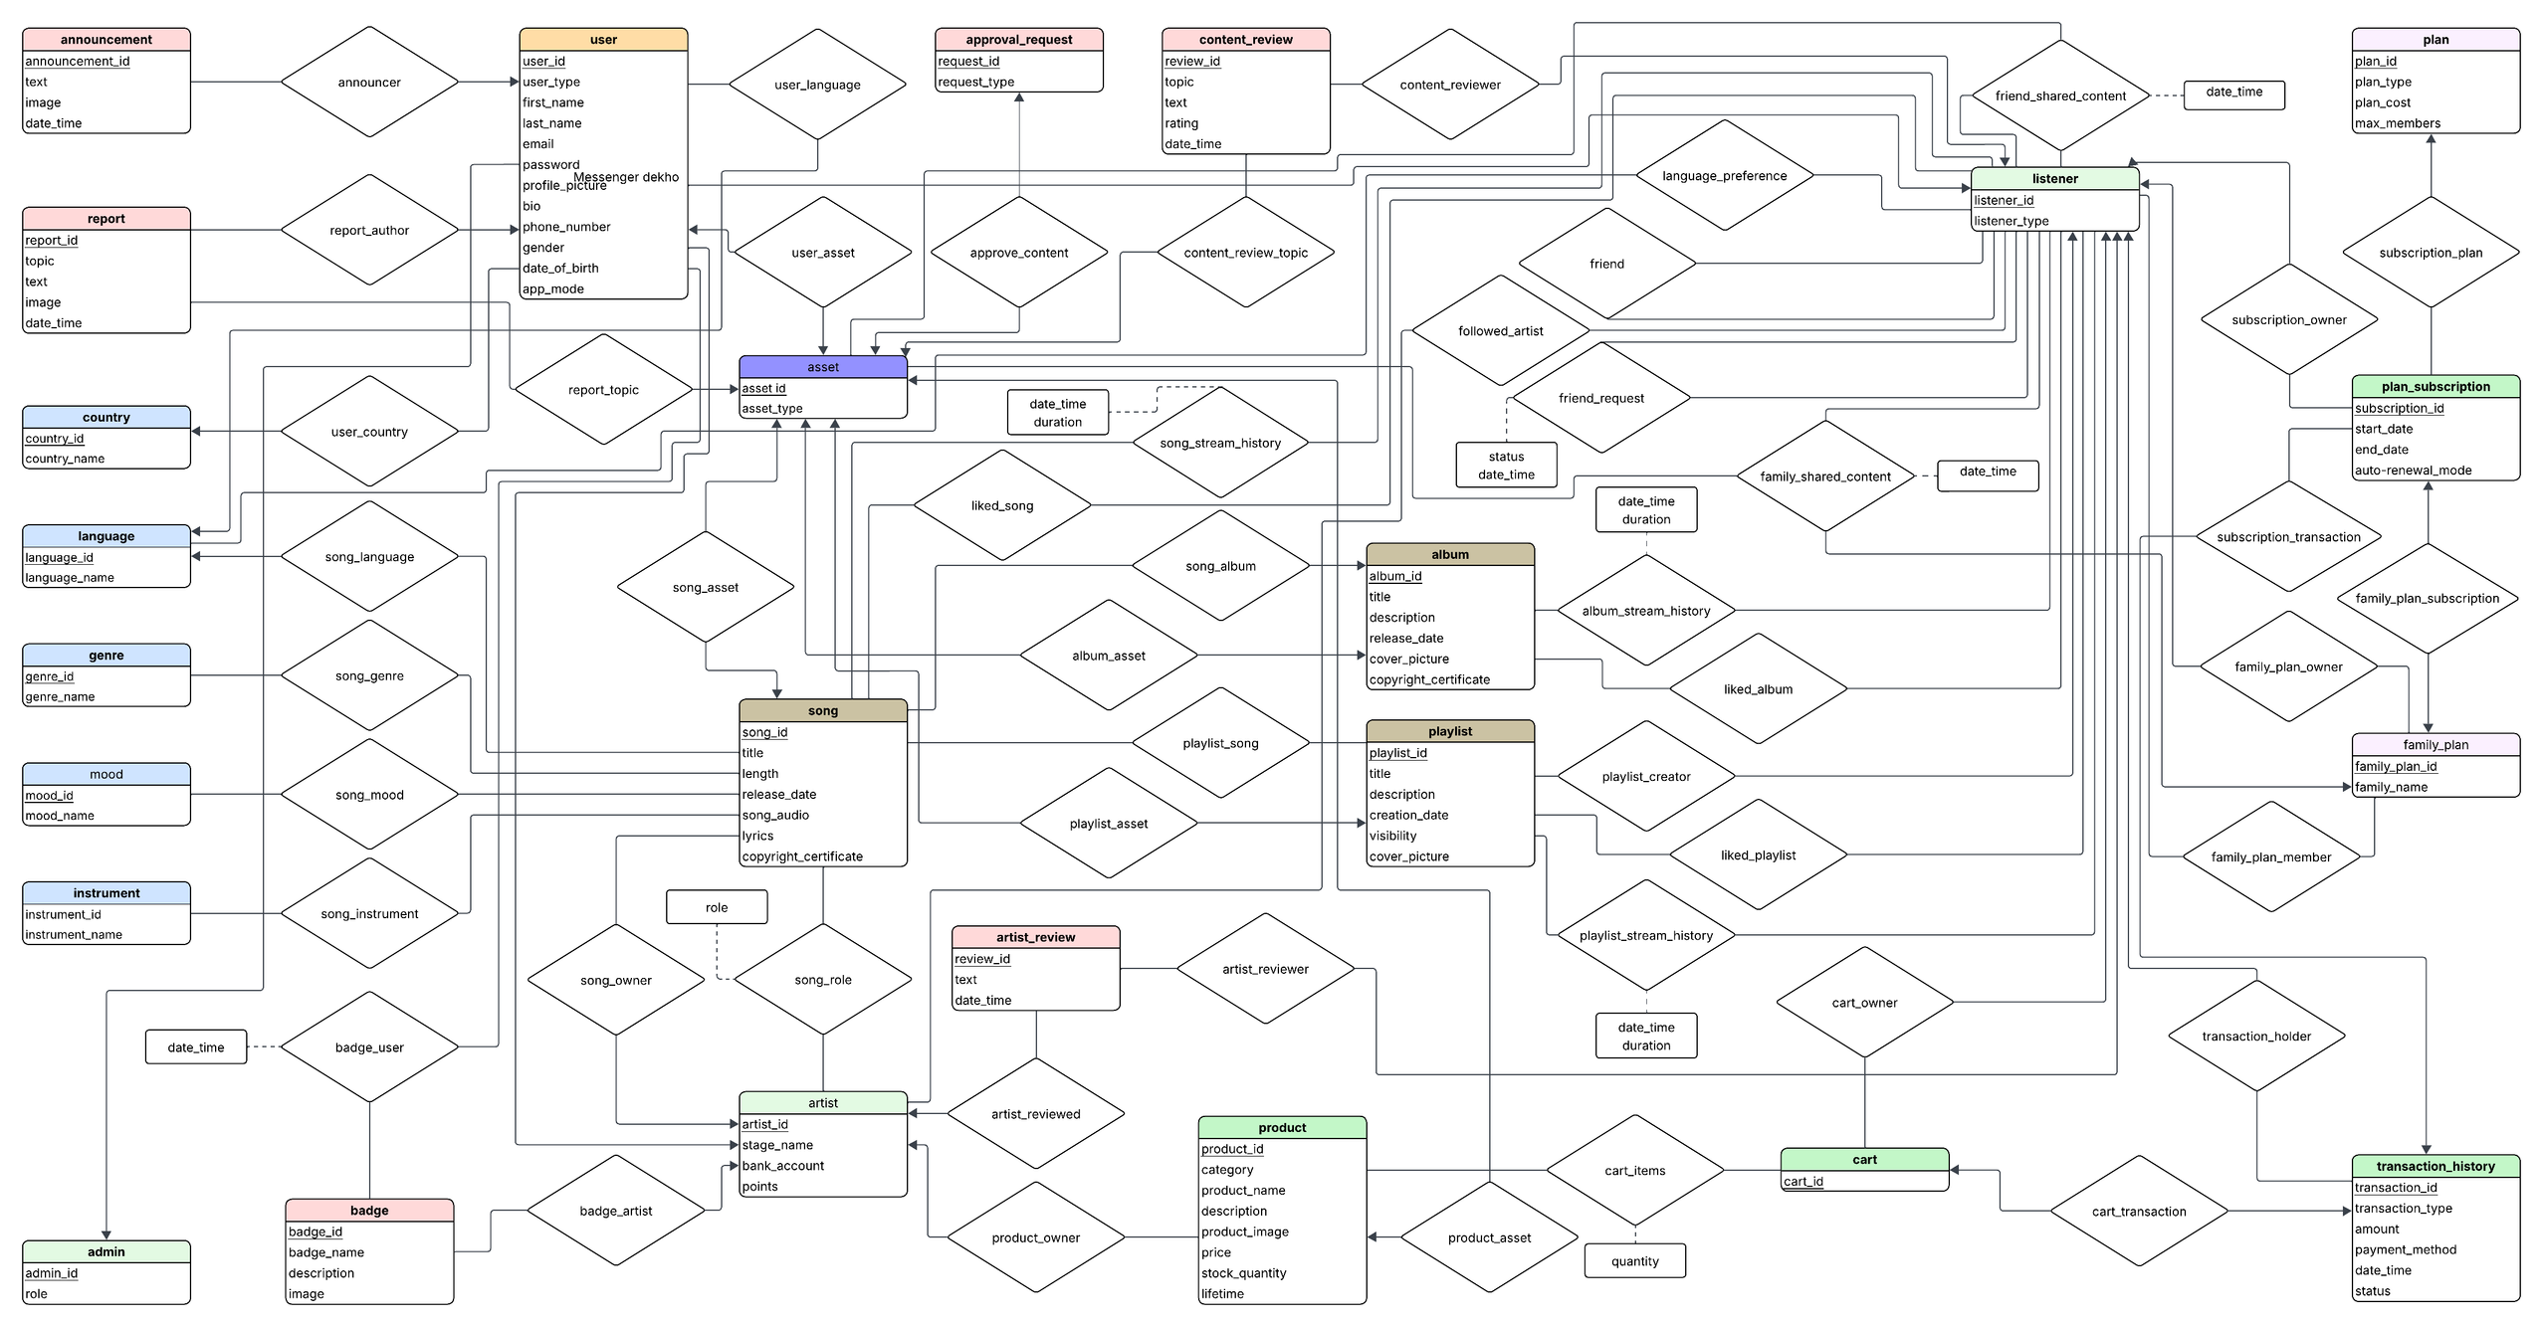

Slide 4
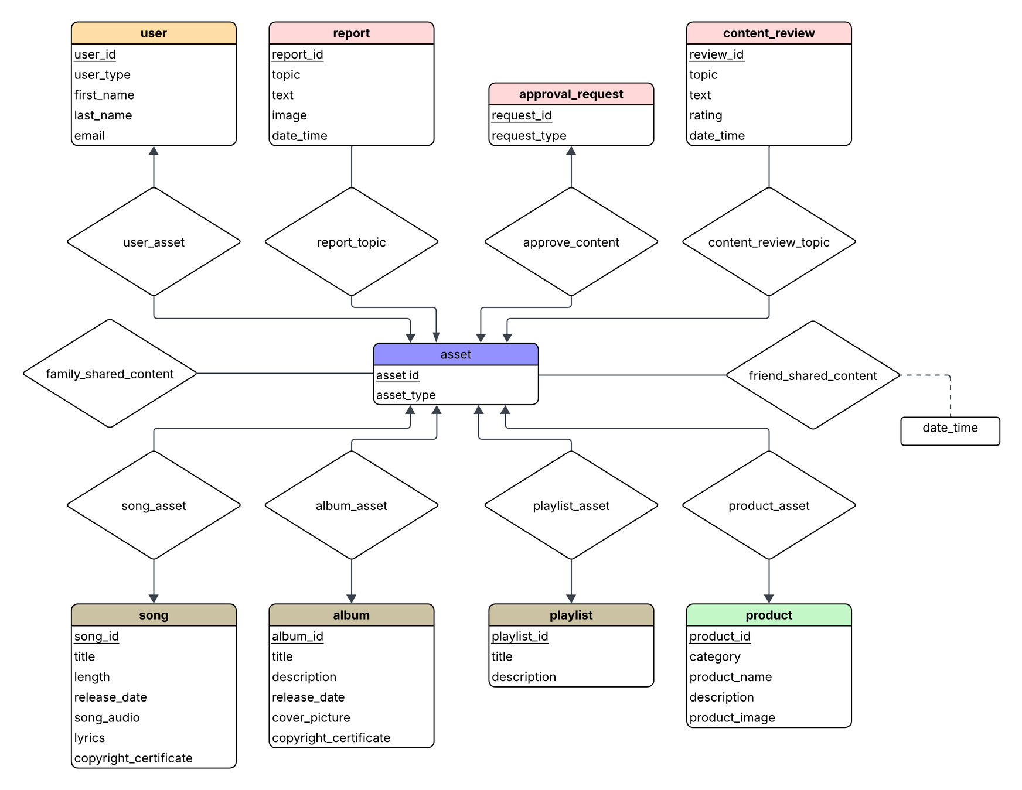
Asset

Slide 5
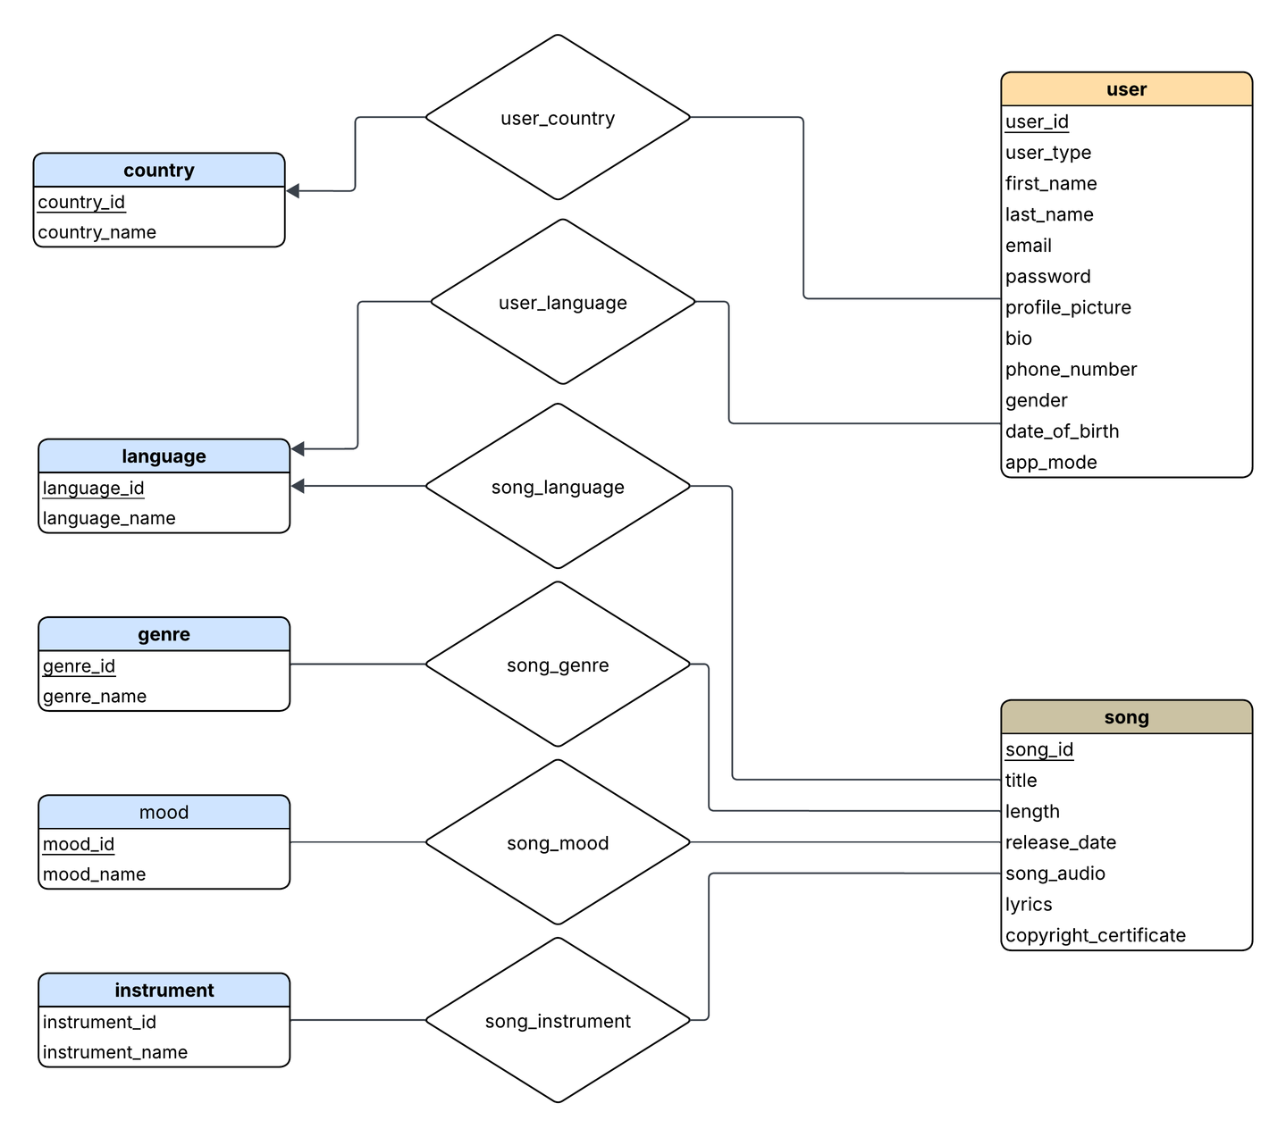
Categories

Slide 6
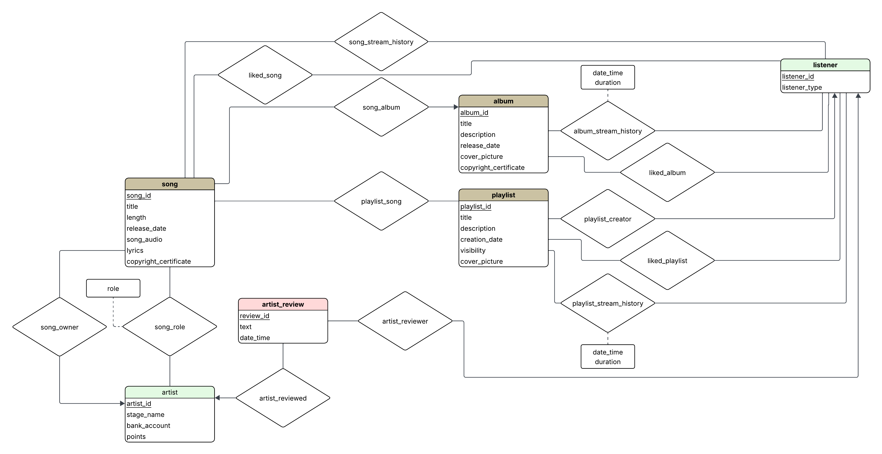
Song

Slide 7
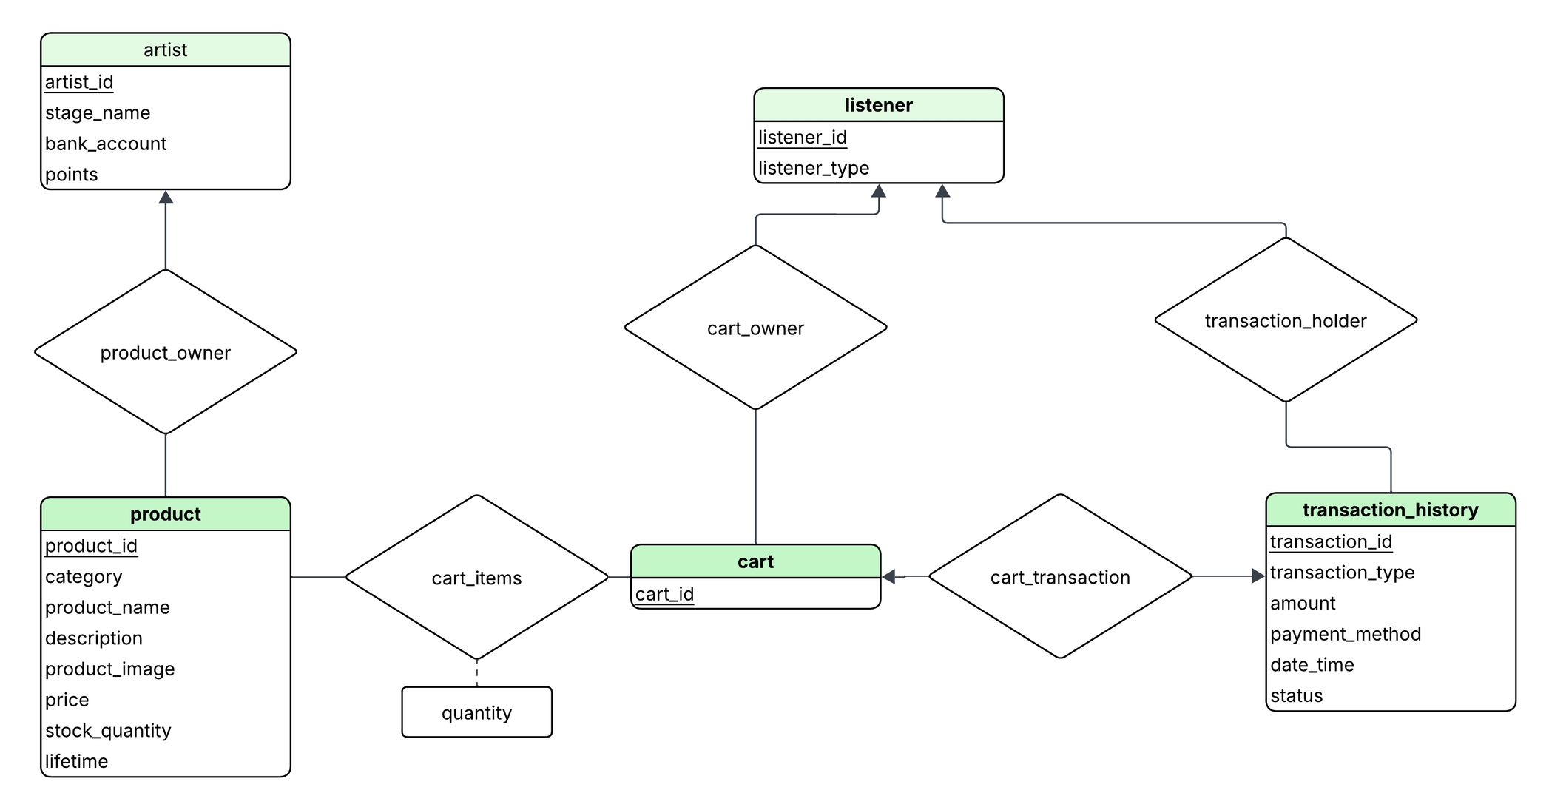
Products

Slide 8
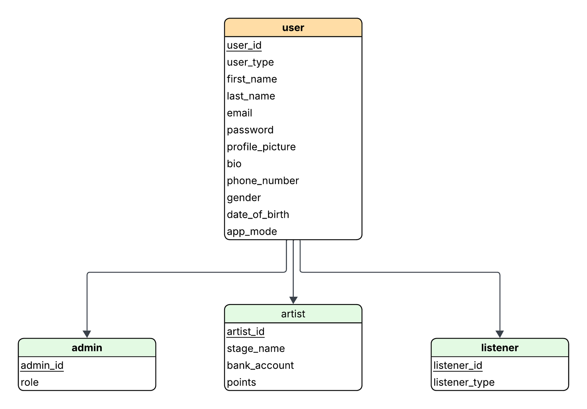
Users

Slide 9
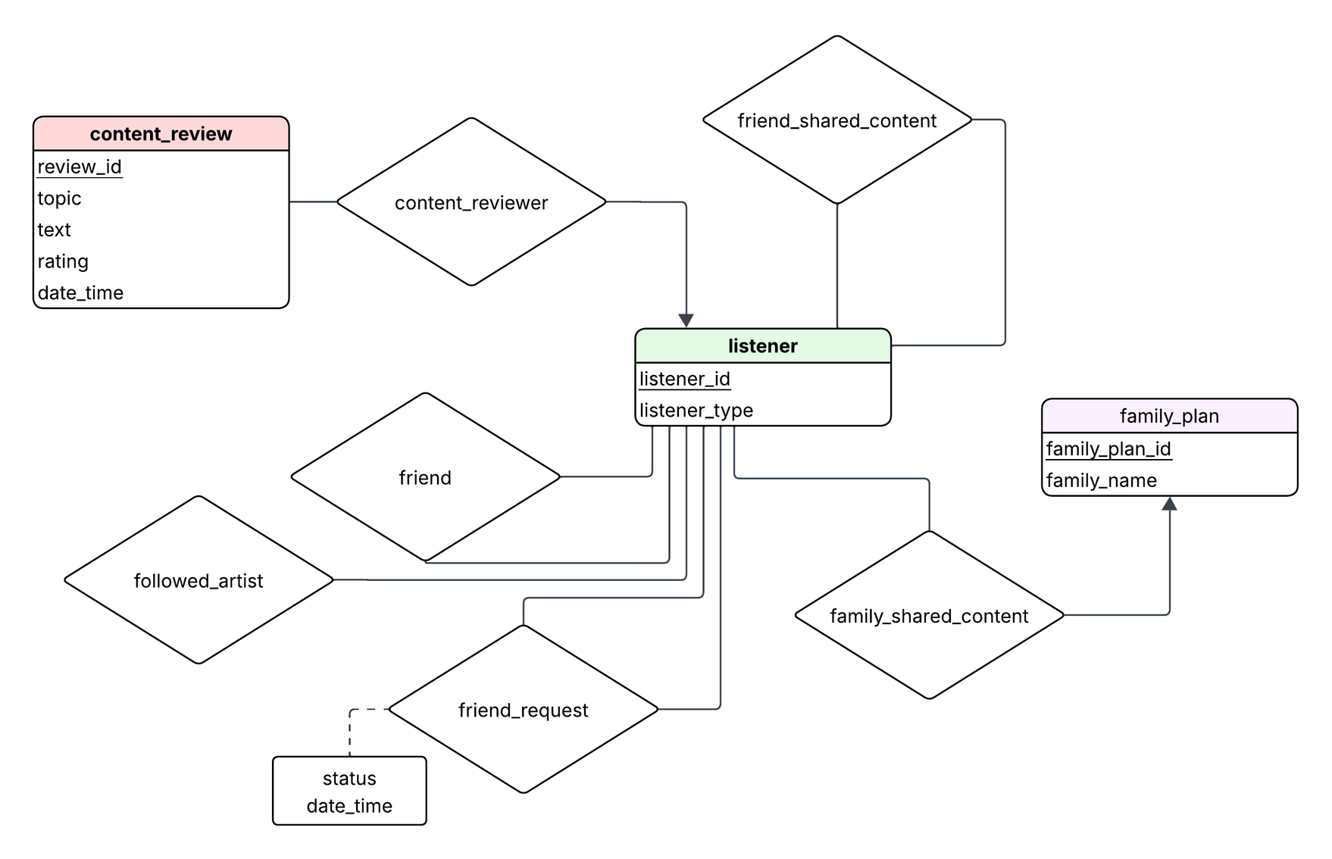
Social

Slide 10
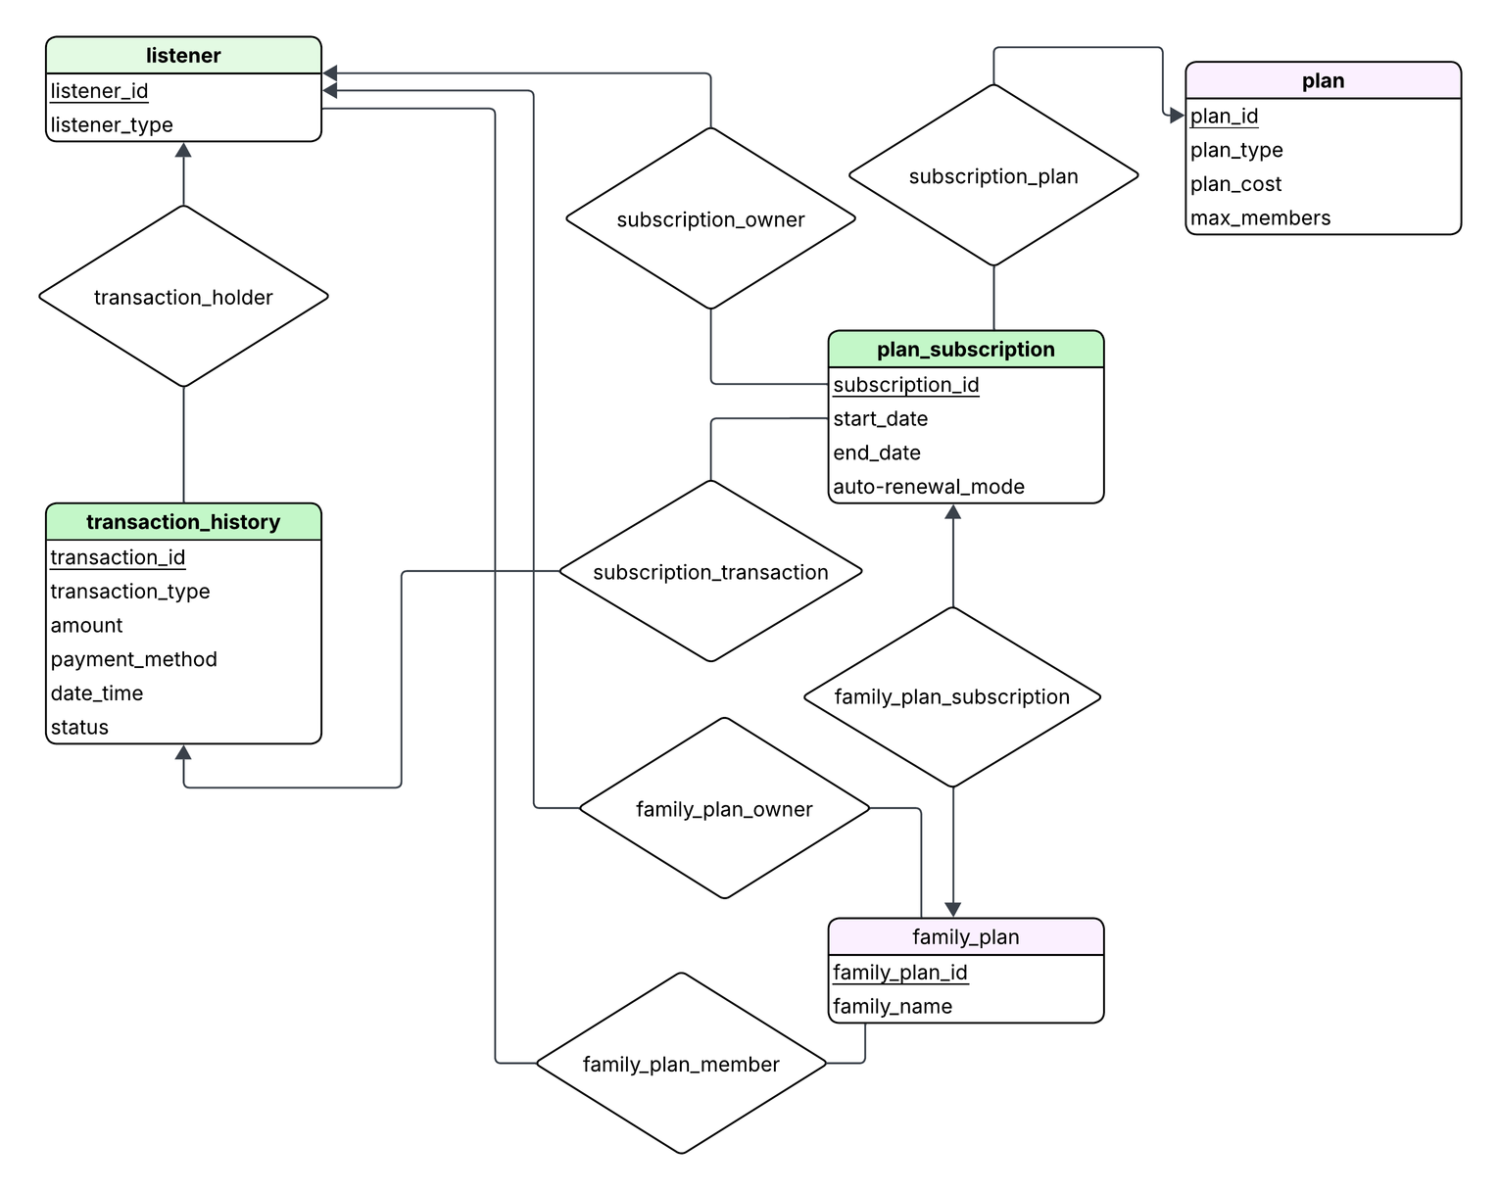
Subscription Models

Slide 12
THANK YOU
Supervised by:
Kowshic Roy
Lecturer at CSE, BUET
Presented by:
Shadman Sami
Ramisa Raidah Arana

